Slide 1
TOPIC: Phishing Awareness Training NAME: Kareem Folashade Kafayat Cyber Security Internship - CodeAlpha

Slide 2
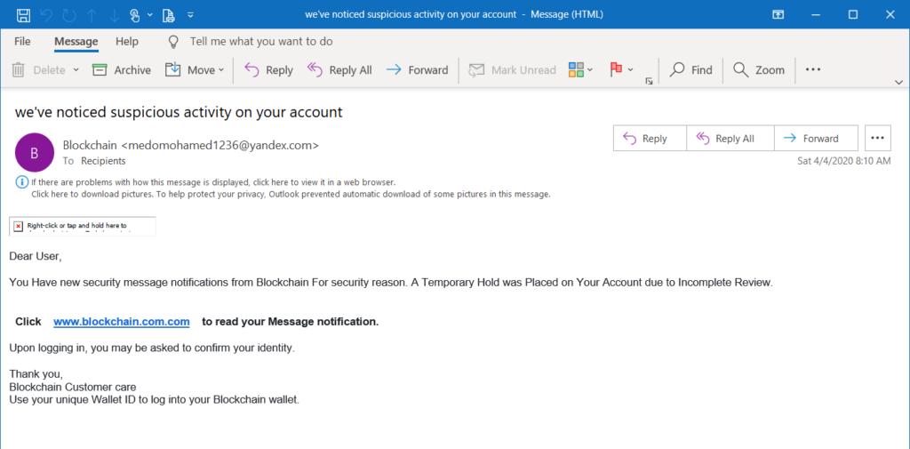
What is Phishing
Phishing is cyber attack where attackers trick people into revealing sensitive information like passwords, bank details, or OTP’S.

Slide 3
TYPES OF PHISHING
Common Types of Phishing
Email Phishing: Fake emails pretending to be from trusted companies.
Smishing: Phishing through SMS text messages.
Vishing: Voice phishing through phone calls.
Website Phishing: Fake login pages designed to steal credentials.

Slide 4
How Phishing Works
Phishing Attack Process
Attacker creates fake emails or website.
Victim receives suspicious message.
Victim clicks malicious link.
Fake website requests login details.
Information is stolen.

Slide 5
Signs of Phishing Emails
Warning Signs
Unknown sender.
Urgent requests.
Grammar or spelling mistakes.
Suspicious links.
Requests for paswords or OTPS.

Slide 6
Social Engineering Tactics
Techniques Used by Attackers
Fear: Your account will be blocked immediately!
Urgency: Respond within 24 hours!
Greed: You won a free prize!
Trust: Pretending to be banks or government agencies.

Slide 7
Real-Life Examples
Common Examples
Fake bank verification emails.
Fake Netflix renewal notices.
Fake Paypal alerts.
Fake WhatsApp verification messages.

Slide 8
How to Stay Safe
Protection Tips
Never click unknown links.
Verify email addresses.
Enable two-factor authentication.
Use antivirus software.
Use strong passwords.

Slide 9
What To Do If Attacked
Response Steps
Disconnect from the internet.
Change passwords immediately.
Inform your IT department.
Scan device for malware.
Report the phishing attack.

Slide 10
Interactive Quiz
What is phishing?
Should you trust unknown links?
What does 2FA mean?
Name one sign of a phishing email.
What should you do after a phishing attack?

Slide 11
Conclusion
Cyber security awareness is the first line of defense against phishing attacks. Users must remain vigilant and verify suspicious communication before taking action.

